Slide 1
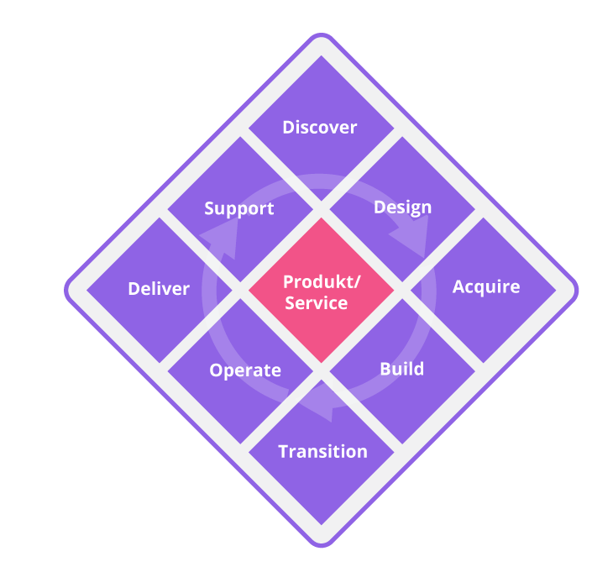
The effect
Principles, Practices and Activities support and interact with each other all the time
Start where you are
Focus on Value
Service
Request
Service Desk
Progress iteratively with feedback
Incident
Optimise & automate
General Practices
Problem
Product Practices
Collaborate & promote visibility
Governance
Keep it simple and practical
Think and work holistically

Slide 2
It is like the Great British Bake off
Principles are the baking techniques
How to use an oven
How to make pastry
How to whisk eggs
Practices are the ingredients
Flour
Eggs
Water
Cream
Activities are the recipe
Add the flour to a bowl
Break the eggs in
Whisk

