Slide 1
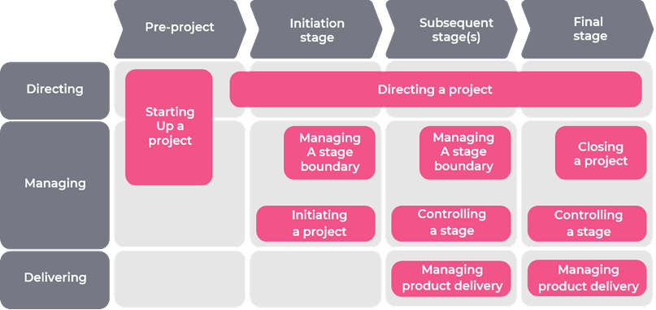
The effect
Learn from experience
Principles, Practices and Processes interact with each other all the time
Continued business justification
Organisation
Business Case
Defined roles and responsibilities
Plans
Tailor to suit the project
Quality
Progress
Issues
Manage by stages
Risk
Focus on products
Manage by exception

Slide 2
It is like Koko Suomi leipoo
Principles are the baking techniques
How to use an oven
How to make pastry
How to whisk eggs
Practices are the ingredients
Flour
Eggs
Water
Cream
Processes are the recipe
Add the flour to a bowl
Break the eggs in
Whisk

