Slide 1
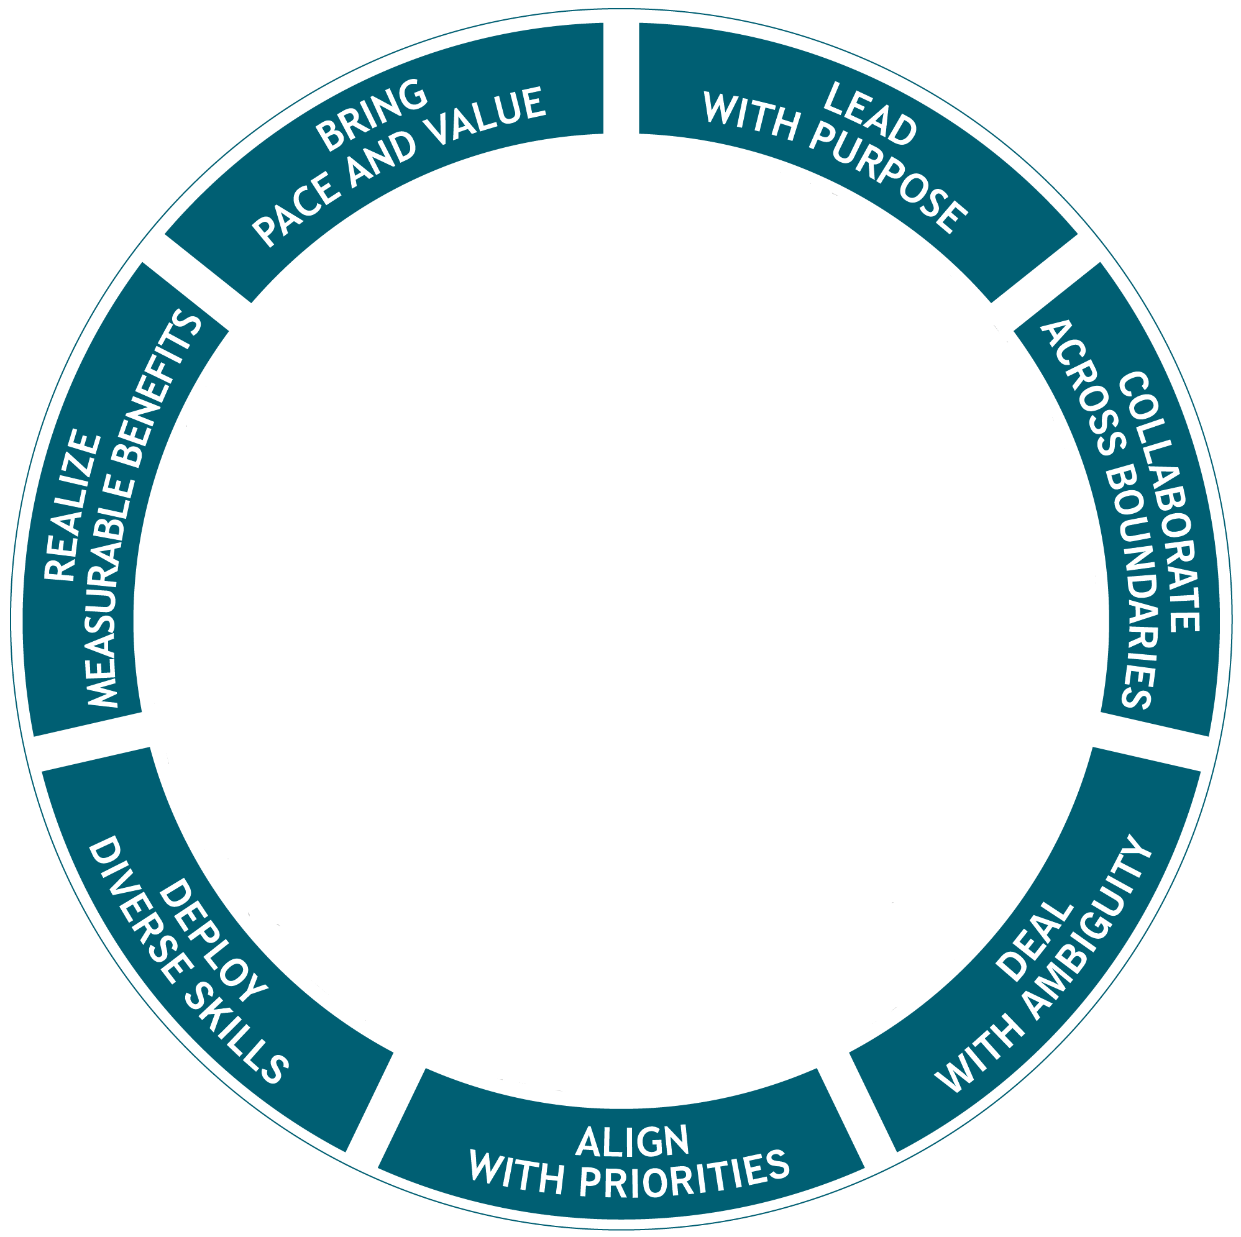
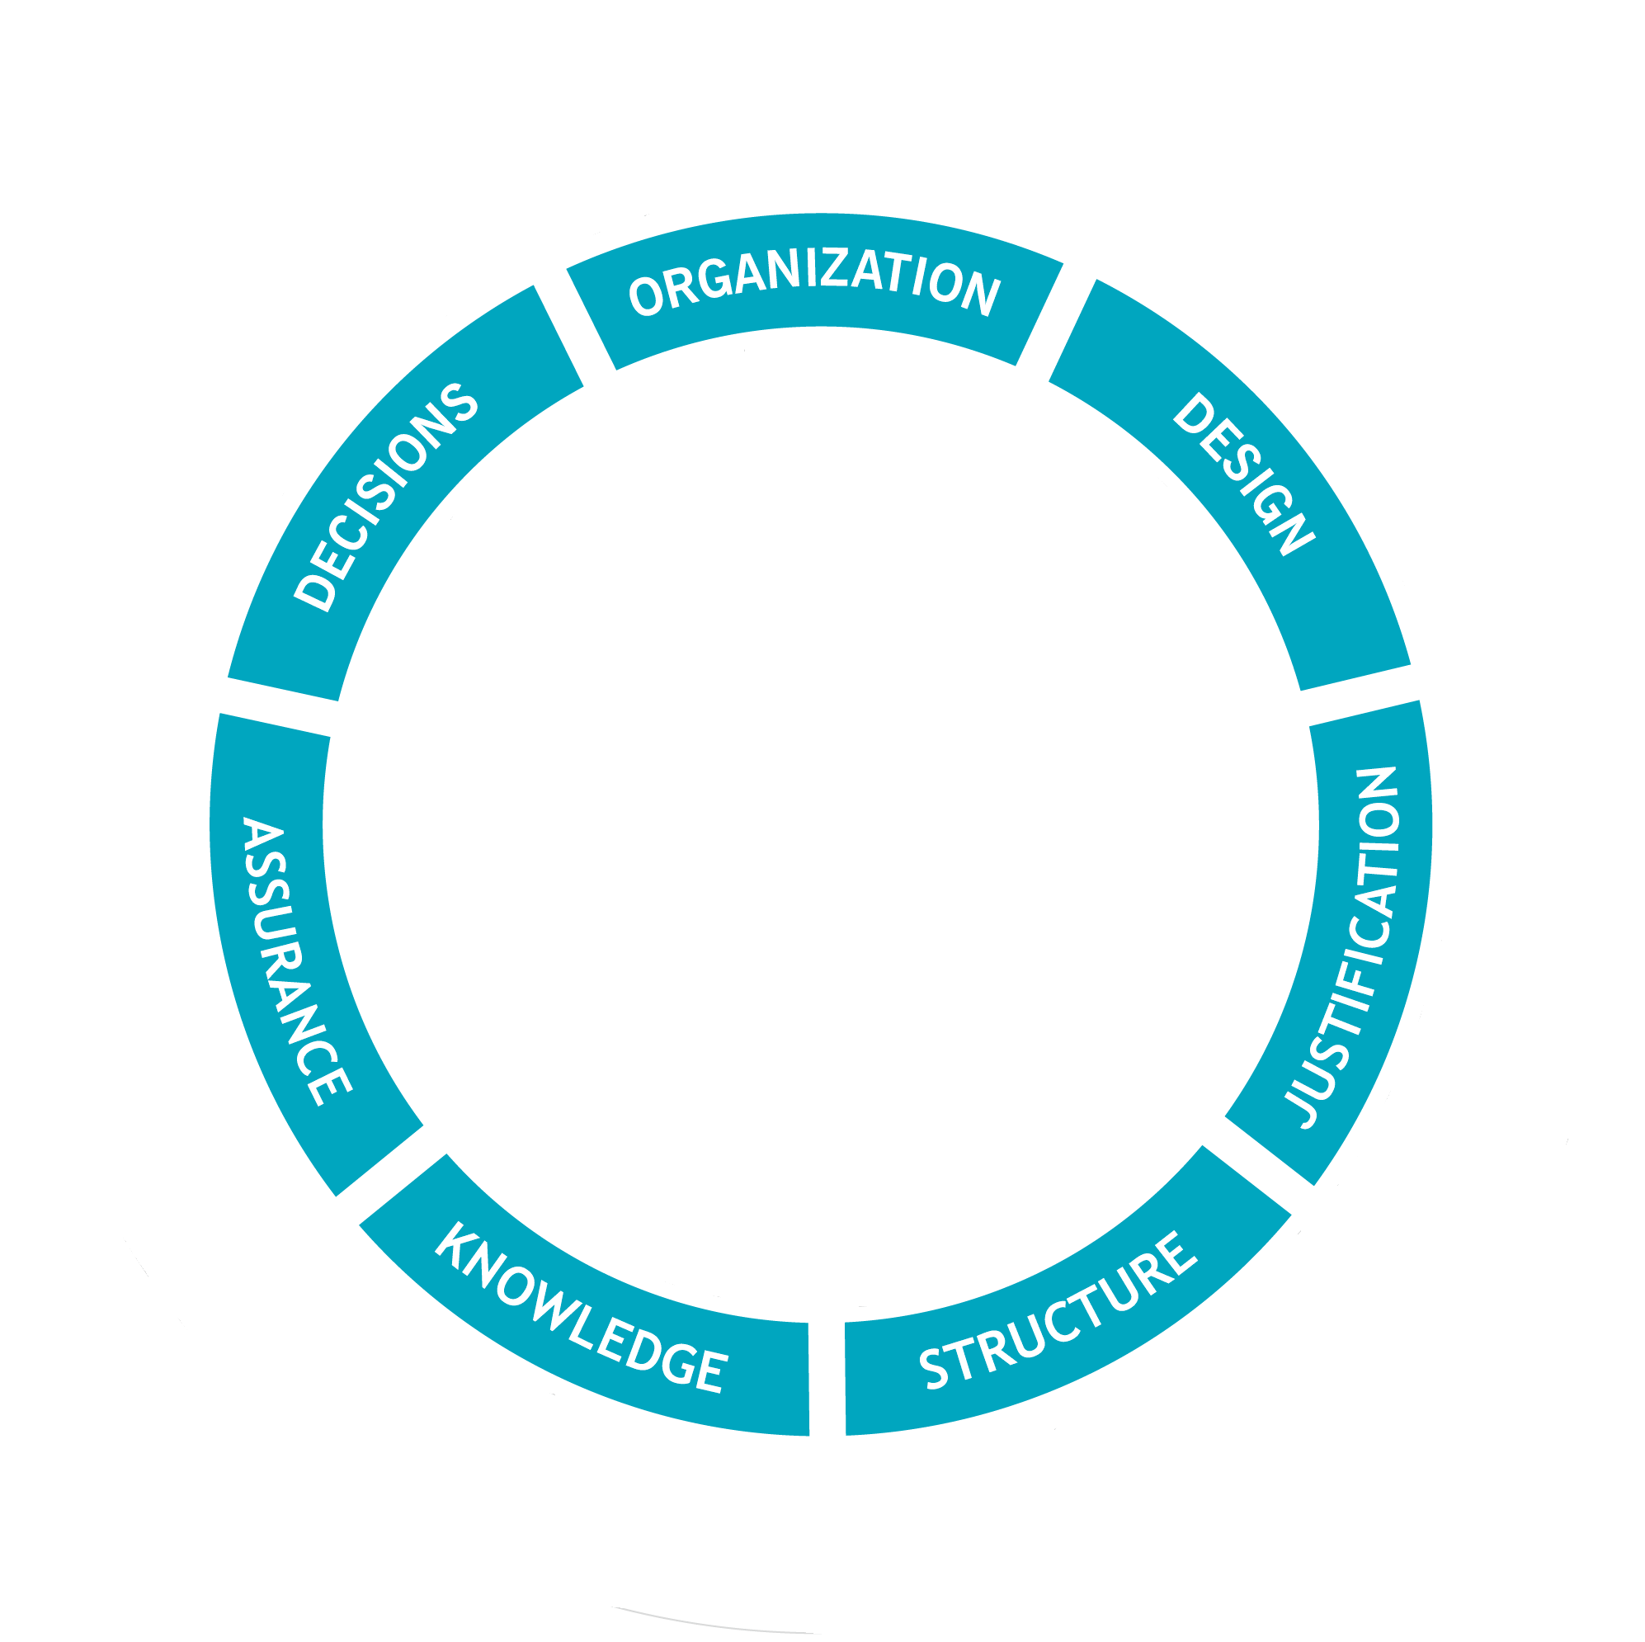
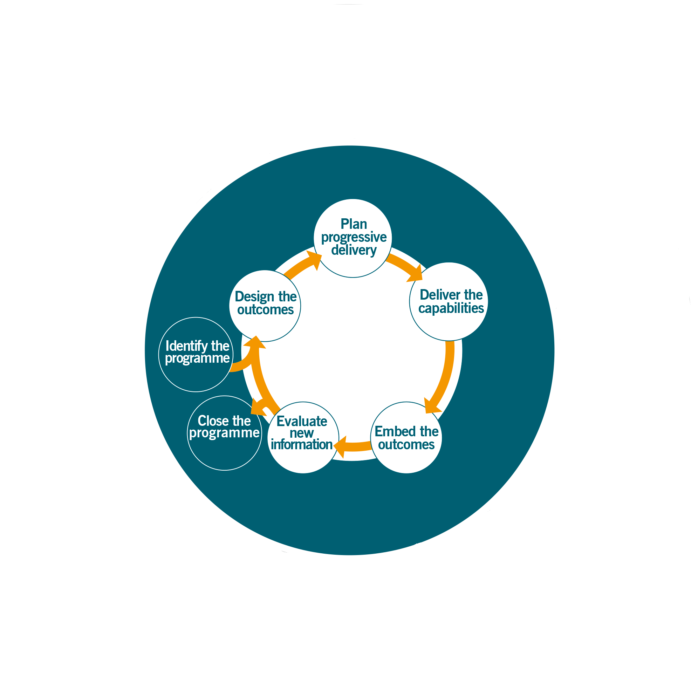
The effect
Principles, Themes and Processes interact with each other all the time
Notes:
Principles, Themes and Processes interact with each other all the time
The Processes is where the work is done.
The Themes offer guidance as to how one does that work. How should organize the people in the programme, how do design the outcomes etc
The Principles apply across the programme and ensure.

Slide 2
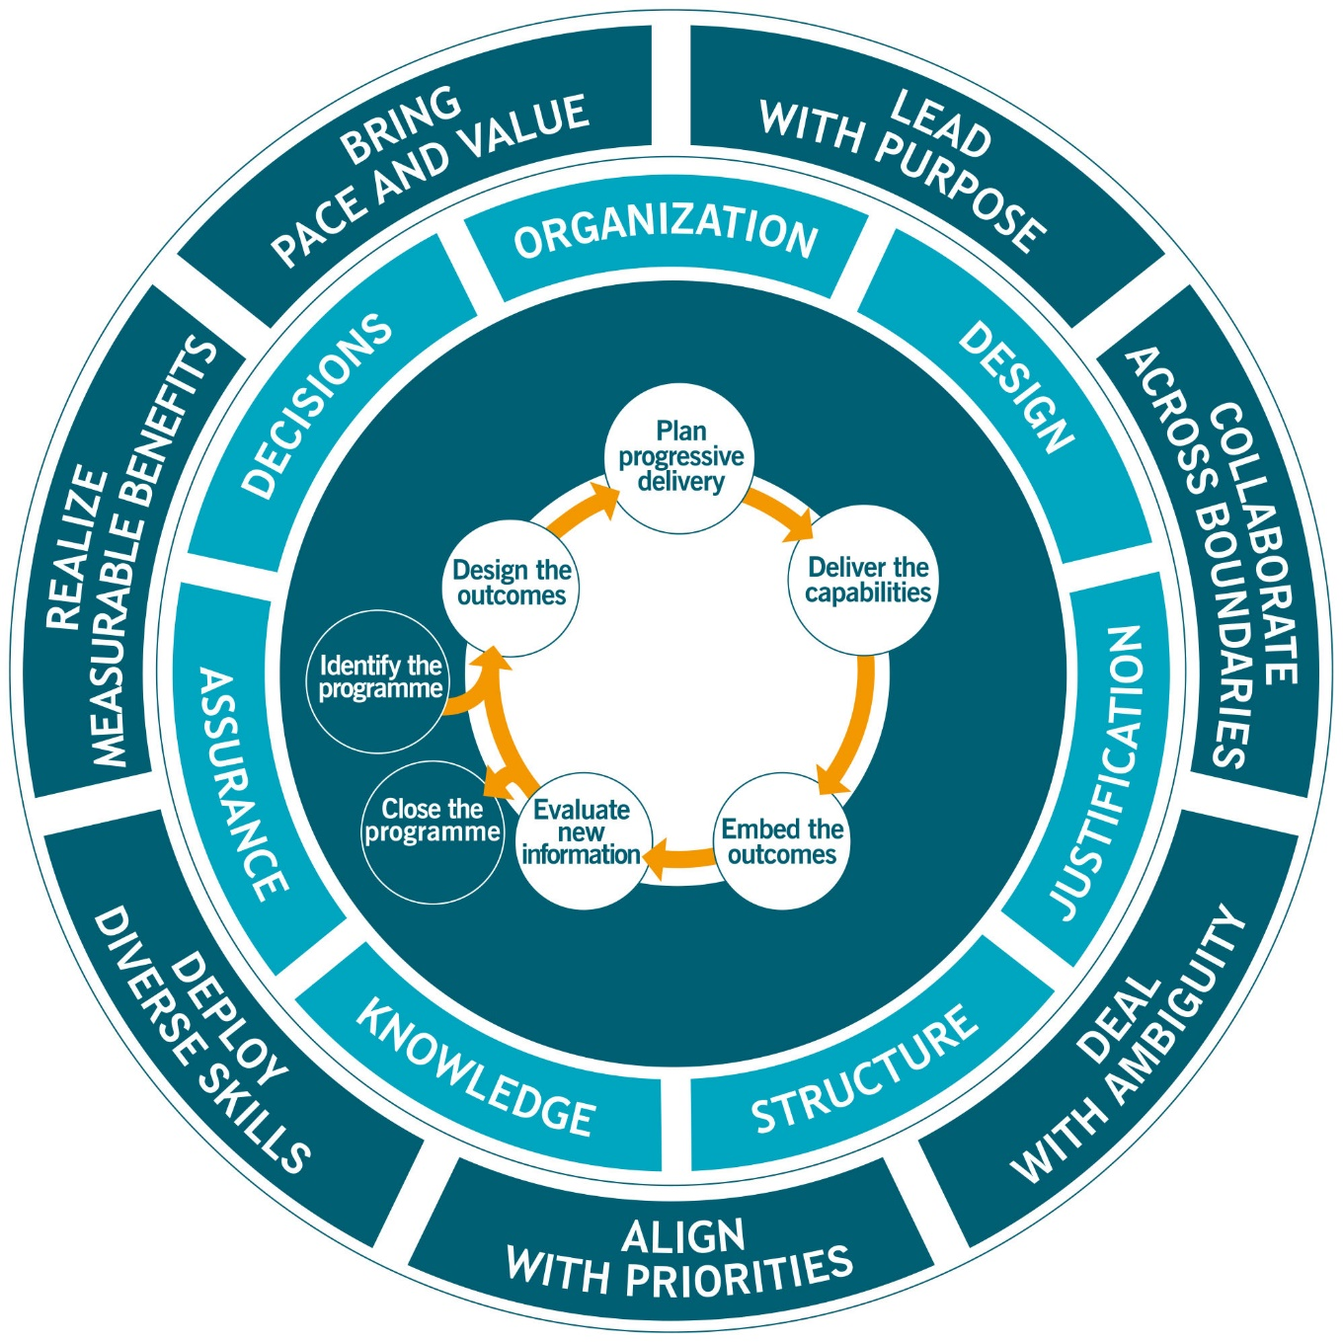
It is like the Great British Bake off
Principles are the baking techniques
How to use an oven
How to make pastry
How to whisk eggs
Themes are the ingredients
Flour
Eggs
Water
Cream
Processes are the recipe
Add the flour to a bowl
Break the eggs in
Whisk

